Slide 1


Modelling and Simulation of Marine Surface Vessel Dynamics (Module 10: Software and Rapid Model Prototyping)
Dr Tristan Perez
Centre for Complex Dynamic Systems and Control (CDSC)
Professor Thor I Fossen
Department of Engineering Cybernetics

Slide 2
MSS – Marine Systems Simulator
GNC Toolbox (m-file library and Simulink blocks) Ref. T. I. Fossen Marine Control Systems (2002)
Hydro (m-file library for hydrodynamic post-processing of hydrodynamic data + Simulink blocks for time-domain simulation of vessel responses in 6 DOF). Ref. T. Perez and T. I. Fossen (new book with worked examples, in progress)

Slide 3
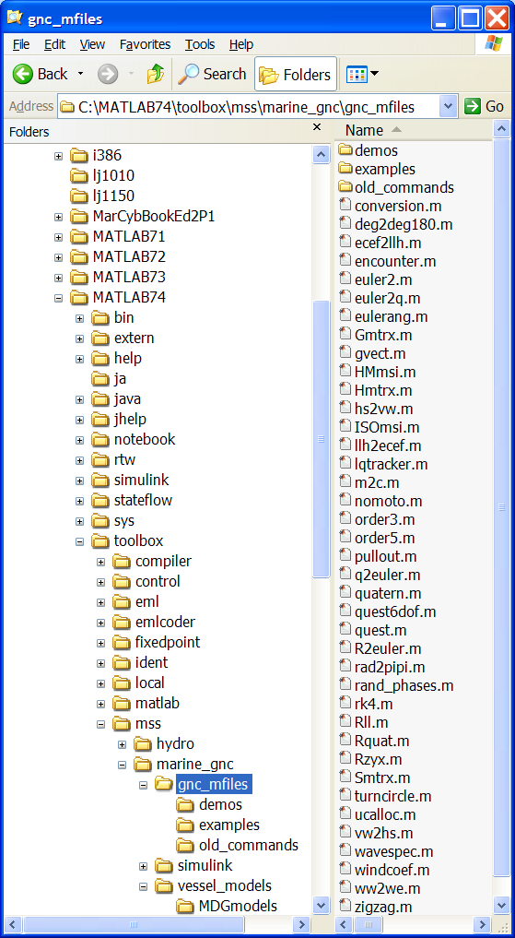
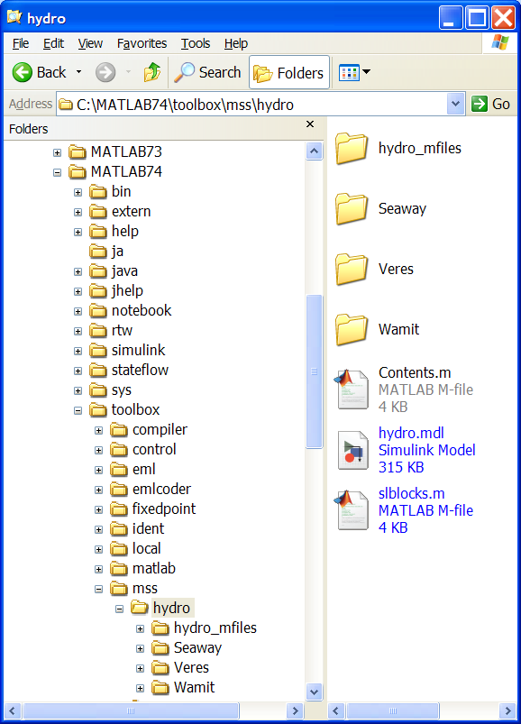

Slide 4
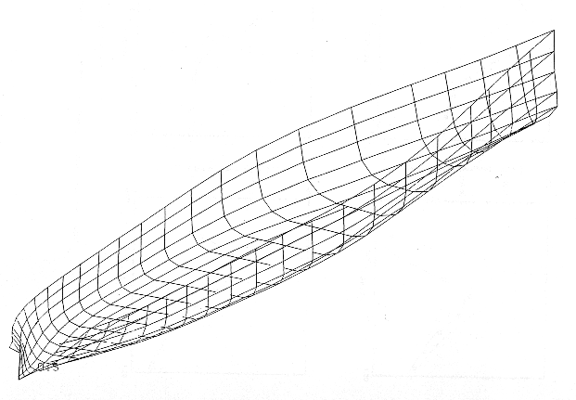
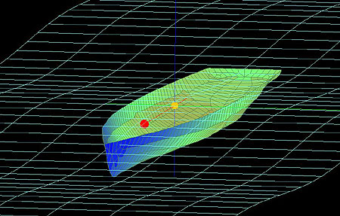
From Vessel Body Plan to MSS
1. Body plan (general arrangement)
- Drawing can be scanned and digitalized manually
- Geometry file: AutoCad, ShipX, Wamit, Napa, etc.
2. Hydrodynamic Configuration and Computations
- SW: Wamit, Shipx (VERES), Octopus (SEAWAY) etc.
- Computes:
Frequency-dependent added mass and potential damping
Restoring forces
Froude-Krylov and diffraction forces (1st-order wave loads)
Wave drift (2nd-order wave loads)
Viscous roll damping (Ikeda damping etc.)
3. Post-Processing (MSS Hydro)
- Computes state-space models for frequency-dependent hydrodynamics
- Add viscous damping like linear skin friction, ITTC drag, cross-flow drag
- Add nonlinear maneuvering coefficients
4. Simulink Vessel Simulator (MSS Hydro)
- 6 DOF real-time simulation of vessel position, velocity, and acceleration + wind, current, and wave generators.
- For a floating vessel the resulting model will be described by 100-200 ODEs. Wave load data for different speeds and headings (0-360 deg) are also included.

Slide 5
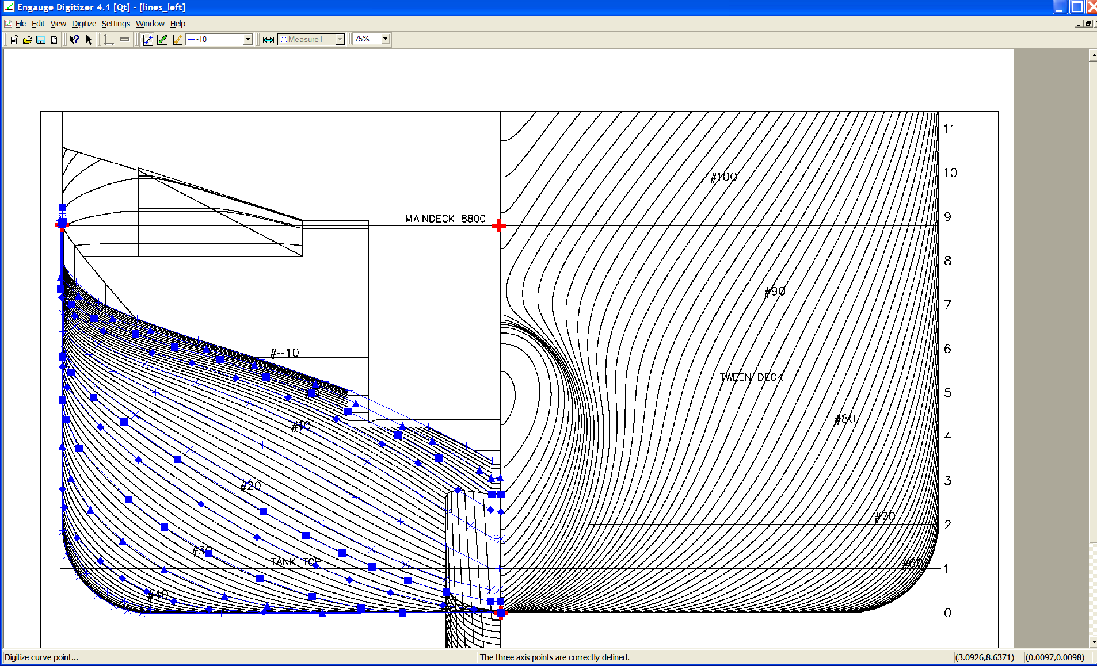
Digitizing the Ship Lines using a Drawing
3 known axes points (x, y)

Slide 6
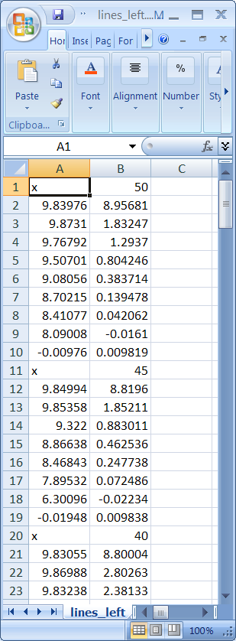
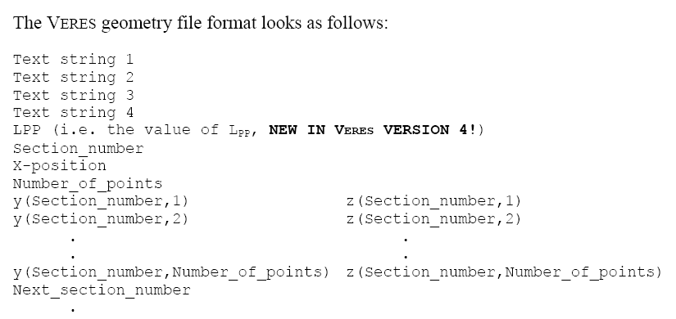
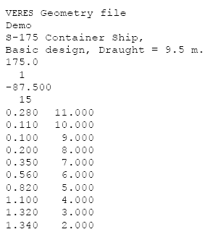
Data Processing – Table of Offsets
The digitized ship sections are exported to Excel in two columns (xz-plan) from Digitizer
Example:
S175 container ship.
Ascii file:
S175.mgf

Slide 7

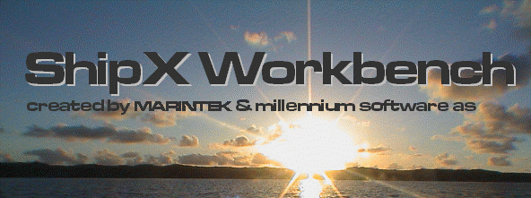
ShipX (VERES) by MARINTEK
MARINTEK - the Norwegian Marine Technology Research Institute - does research and development in the maritime sector for industry and the public sector. The Institute develops and verifies technological solutions for the shipping and maritime equipment industries and for offshore petroleum production.
VERES - VEssel RESponse program is a Strip Theory Program which calculates wave-induced loads on and motions of mono-hulls and barges in deep to very shallow water. The program is based on the famous paper by Salvesen, Tuck and Faltinsen (1970). Ship Motions and Sea Loads. Trans. SNAME.

Slide 8
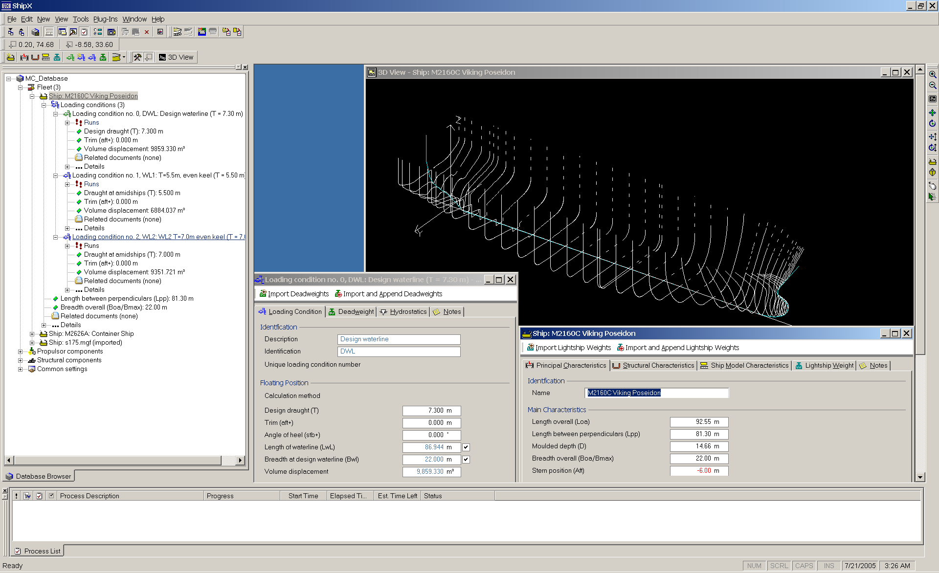

Slide 9
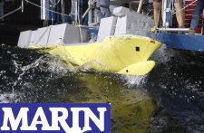
OCTOPUS SEAWAY by Amarcon
and AMARCON cooperate in further development of SEAWAY
The Maritime Research Institute Netherlands (MARIN) and AMARCON agree to cooperate in further development of SEAWAY. MARIN is an internationally recognized authority on hydrodynamics, involved in frontier breaking research programs for the maritime and offshore industries and navies.
SEAWAY is developed by Professor J.M.J. Journée at the Delft Univ. of Technology
SEAWAY is a Strip Theory Program to calculate wave-induced loads on and motions of mono-hulls and barges in deep to very shallow water. When not accounting for interaction effects between the hulls, also catamarans can be analyzed. Work of very acknowledged hydromechanic scientists (like Ursell, Tasai, Frank, Keil, Newman, Faltinsen, Ikeda, etc.) has been used, when developing this code.
SEAWAY has extensively been verified and validated using other computer
codes and experimental data.

Slide 10
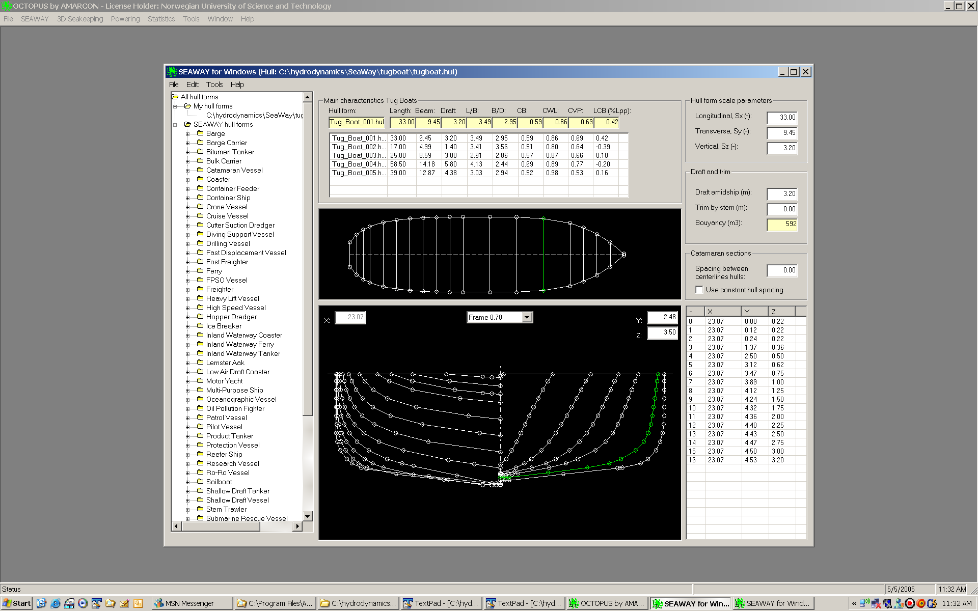

Slide 11
WAMIT (Vers. 6.3) by WAMIT INC.
WAMIT® is the most advanced set of tools available for analyzing wave interactions with offshore platforms and other structures or vessels.
WAMIT® was developed by Professor Newman and coworkers at MIT in 1987, and it has gained widespread recognition for its ability to analyze the complex structures with a high degree of accuracy and efficiency.
3D Panelization of
a Supply Vessel
Over the past 20 years WAMIT has been licensed to more than 90 industrial and research organizations worldwide.

Slide 12
Hydrodynamic Methods (MSS Hydro)
Frequency-Dependent Hydrodynamic Added Mass, Potential Damping, and Restoring Forces: Computed using: WAMIT, ShipX (VERES), or Octopus SEAWAY
Nonlinear Viscous Damping and Current Loads:
ITTC quadratic drag formulation/ added resistance in surge (includes current)
Nonlinear cross-flow drag in sway and yaw (includes currents)
Munk moment in yaw from potential coefficients
Higher order nonlinear damping terms in heave, roll, and pitch (manually added)
Maneuvering coefficients (manually added)
Nonlinear Frequency-Dependent Damping in Roll due to Bilge Keels and Anti-Rolling Tanks: Can be computed in ShipX (VERES) and Octopus (SEAWAY)
Frequency-Dependent Linear Viscous Damping in DOFs 1,2,6: Manually added using exponential decaying functions for skin friction
Wave Loads: 1st-order (Froude-Krylov and diffraction) and 2nd-order wave loads (wave drift) are computed using 2D/3D potential theory
Wind Loads: Computed using wind coefficient tables

Slide 13
Output (Ascii-files) from Hydrodynamic Codes
VERES
*.re1
*.re2
SeaWay
*.out
WAMIT
*.x

Slide 14
Postprocessing of the Hydrodynamic Data Files to the MSS vessel structure
Extract necessary information from the ASCII files generated by the hydrodynamic code
Scaling of data
Change and translate coordinate frames for hydrodynamic coefficients, RAOs, transfer functions etc.
Add viscous effects (hydrodynamic codes are non-viscous/potential theory)
Process data for time-domain simulation
Notice that the MSS vessel structure is independent of the hydrodynamic code!
MSS Hydro toolbox commands: >> veres2vessel.m
>> wamit2vessel.m
>> seaway2vessel.m

Slide 15
MSS Hydro Vessel Structure
xxx

Slide 16
Example: Adding Viscous Damping
Added mass A44, A55, A66
Damping B44, B55, B66
Peak is due
to IKEDA
roll damping
theory for
bilge keels
Linear viscous
skin friction
(ramps)

Slide 17
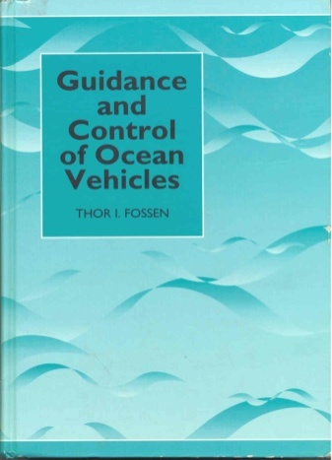
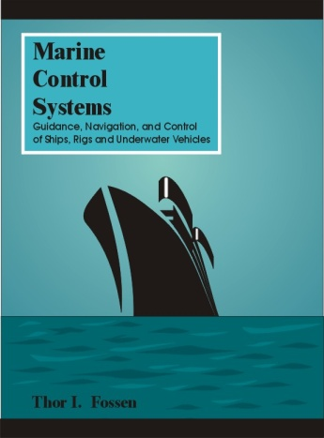
Vectorial Vessel Model Representation for Marine Vessels
From Robotics to Ship Modeling (Fossen 1991, PhD thesis)
Consider the classical robot manipulator model:
- q is a vector of joint angles
- is a vector of torque
- M and C are the system inertia and Coriolis matrices
This model structure can be used as foundation to write the 6 DOF marine vessel equations of motion in a compact vectorial setting (Fossen 1994, 2002):
- body velocities:
- position and Euler angles:
M, C and D denote the system inertia, Coriolis and damping matrices
g is a vector of gravitational and buoyancy forces and moments

Slide 18
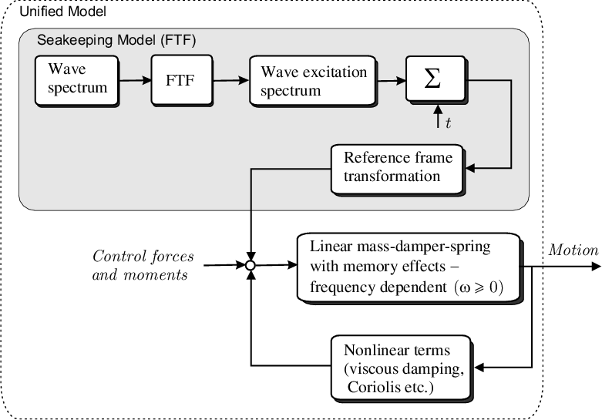
Unified Time-Domain Model for Different Speeds and Different Sea States
The Force-Transfer-Functions are computed using hydrodynamic SW
e.g. WAMIT, VERES or SEAWAY
For 6 DOF this model will typically be represented by 6 + 6 + 90 = 102 ODEs
which are computed using
hydrodynamic e.g. WAMIT, VERES or SEAWAY
These terms are found using experimental results/curve fitting or
semi-empirical methods

